Slide 1


Progress report presentation as part of master’s study and research ongoing at Uganda Martyrs University
Salome Wambui Waweru
2024-M152-24870

Slide 2
Completed UNITS
YEAR 1 SEM 1 | YEAR 1 SEM 2
Systems and Agro ecologies | Ecological Resource Economics and Entrepreneurship
Biotechnology | Integrated Natural Resource Management
Agro Metrology and Ecosystem Modeling | Integrated Crop and Pest Management
Agrobiodiversity and Ecosystem Conservation | Livestock Production Systems
Research & Statistical Methods

Slide 3
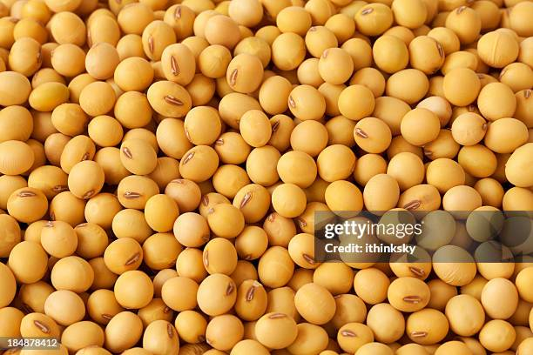
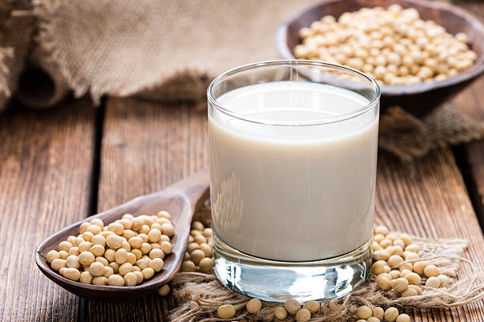
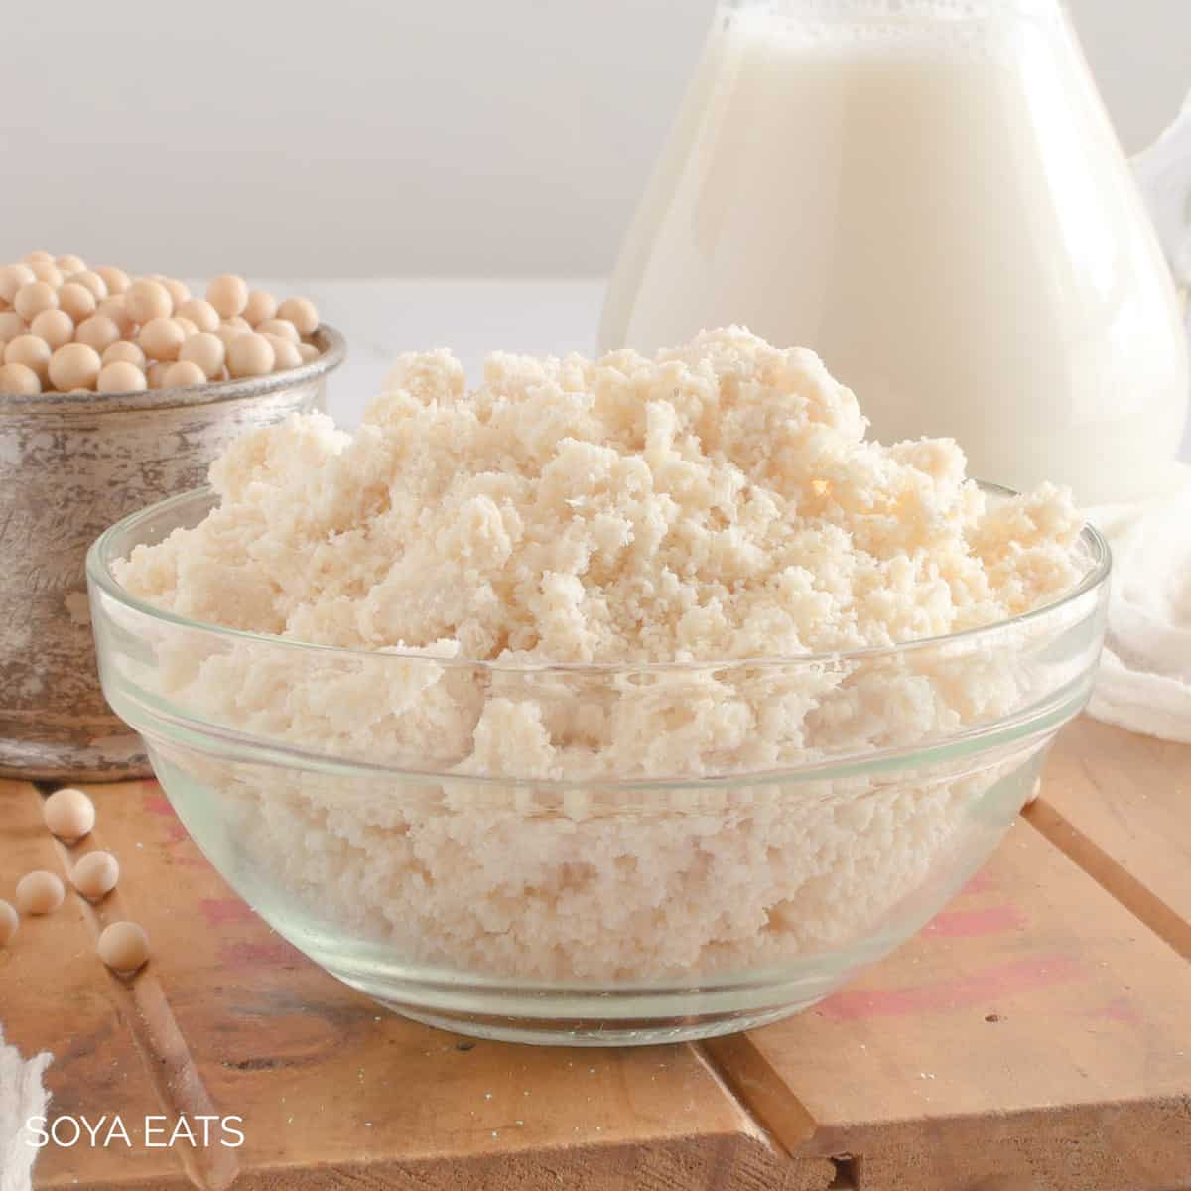
Research TOPIC Effective utilization of Okara (soybean pulp) from soy milk extraction in muffins & cookies to enhance nutritional value and reduce waste
Supervisor: Dr Marius Murongo

Slide 4
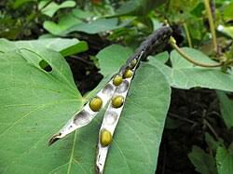
Background
Okara is the soybean pulp remaining after filtering the extract that results from the process of extracting soy milk from Soybean (KeShun Liu, 2015). For every Kg of dry soybean made into soymilk, about 1kg of okara is generated (KeShun Liu, 2015). It is often discarded, contributing to food waste and consequently environmental pollution.
Fresh okara contains 76–80% moisture, 2.6–4.0% protein, and other solids form the remaining component. When dried, okara contains 25.4–28.4% protein, 9.3–10.9% oil, 40.2–43.6% insoluble fiber, 12.6–14.6% soluble fiber, and 3.8–5.3% soluble carbohydrates (Van der Riet et al., 1989).
To control food waste resulting from soymilk extraction, there’s need to utilize the okara and this can be done by integrating it in bakery products as a major ingredient. There is a growing demand for more nutritious and sustainable ingredients in bakery products, making this an opportunity to reduce food waste and enhance the nutritional profile of baked goods.
Okara will be sundried under a solar food drier after soymilk extraction. Bakery products will be made at home using energy saving cooking methods (jikokoa/biogas for baking) as well as 12-hour soaking of soybean in water (as compared to boiling the soybean and using more energy while at it).
Reducing food waste is important because it leads to less garbage, contributes to reduction of greenhouse gas emissions and improves food security among communities as well as contributing towards income generation.

Slide 5

Problem statement
Despite being highly nutritious, the okara resulting from Soymilk extraction from Soybeans is highly underutilized resulting in wastage.
Previously undertaken research has explored the utilization of the okara also known as soy agushie in making soups in West Africa.
There is a lack of research exploring how these by-products can be incorporated into bakery products to enhance their nutritional value while reducing food waste. This research therefore aims at experimenting how okara can be utilized in making bakery products and assessing the acceptability of the resulting products by conducting consumer reviews through product tasting.

Slide 6

Objectives
Evaluating the nutritional content of okara to determine its suitability in making bakery products such as muffins and cookies.
To evaluate the consumer acceptance of bakery products made with okara.
Assess the level of food waste avoided with effective utilization of okara

Slide 7
Data collection
Nutritional Analysis: Okara will be analyzed for its protein, fiber, mineral, and antioxidant content which will be used to indicate the nutritional content of the final products. Bakery products will be made with varying amounts of okara (5%, 10% and 15% of total weight).
Organoleptic Evaluation: A panel will be conducted with a group of consumers to assess the taste, texture, and overall acceptance of the bakery products. The consumers will do this by responding to a questionnaire rating the different perspectives on a Likert Scale with ratings of 1-10.
Waste and Sustainability Assessment: Based on the amount of okara obtained per kg of soybean processed and the resulting soymilk, this data will provide a background to quantify the reduction in waste from soybean processing and determine the environmental impact of using soy by-products compared to traditional bakery ingredients.

Slide 8
Data Analysis
Data Analysis
Statistical tests will be used to compare nutritional data to determine significant differences in nutrient content between okara integrated flour and plain wheat flour.
Organoleptic evaluation results will be analyzed using consumer preference rankings and statistical analysis.
Environmental impact will be analyzed in terms of waste reduction and resource utilization
Currently doing proposal review with my supervisor. Proposal differentiation already completed.
To commence nutritional analysis in October 2025
Organoleptic analysis to be done in December 2025 & January 2026

Slide 9
How far with the research and next steps
Currently doing proposal review with my supervisor. Proposal differentiation done in June 2025.
To commence nutritional analysis in October 2025
Organoleptic analysis to be done in December 2025 & January 2026

Slide 10
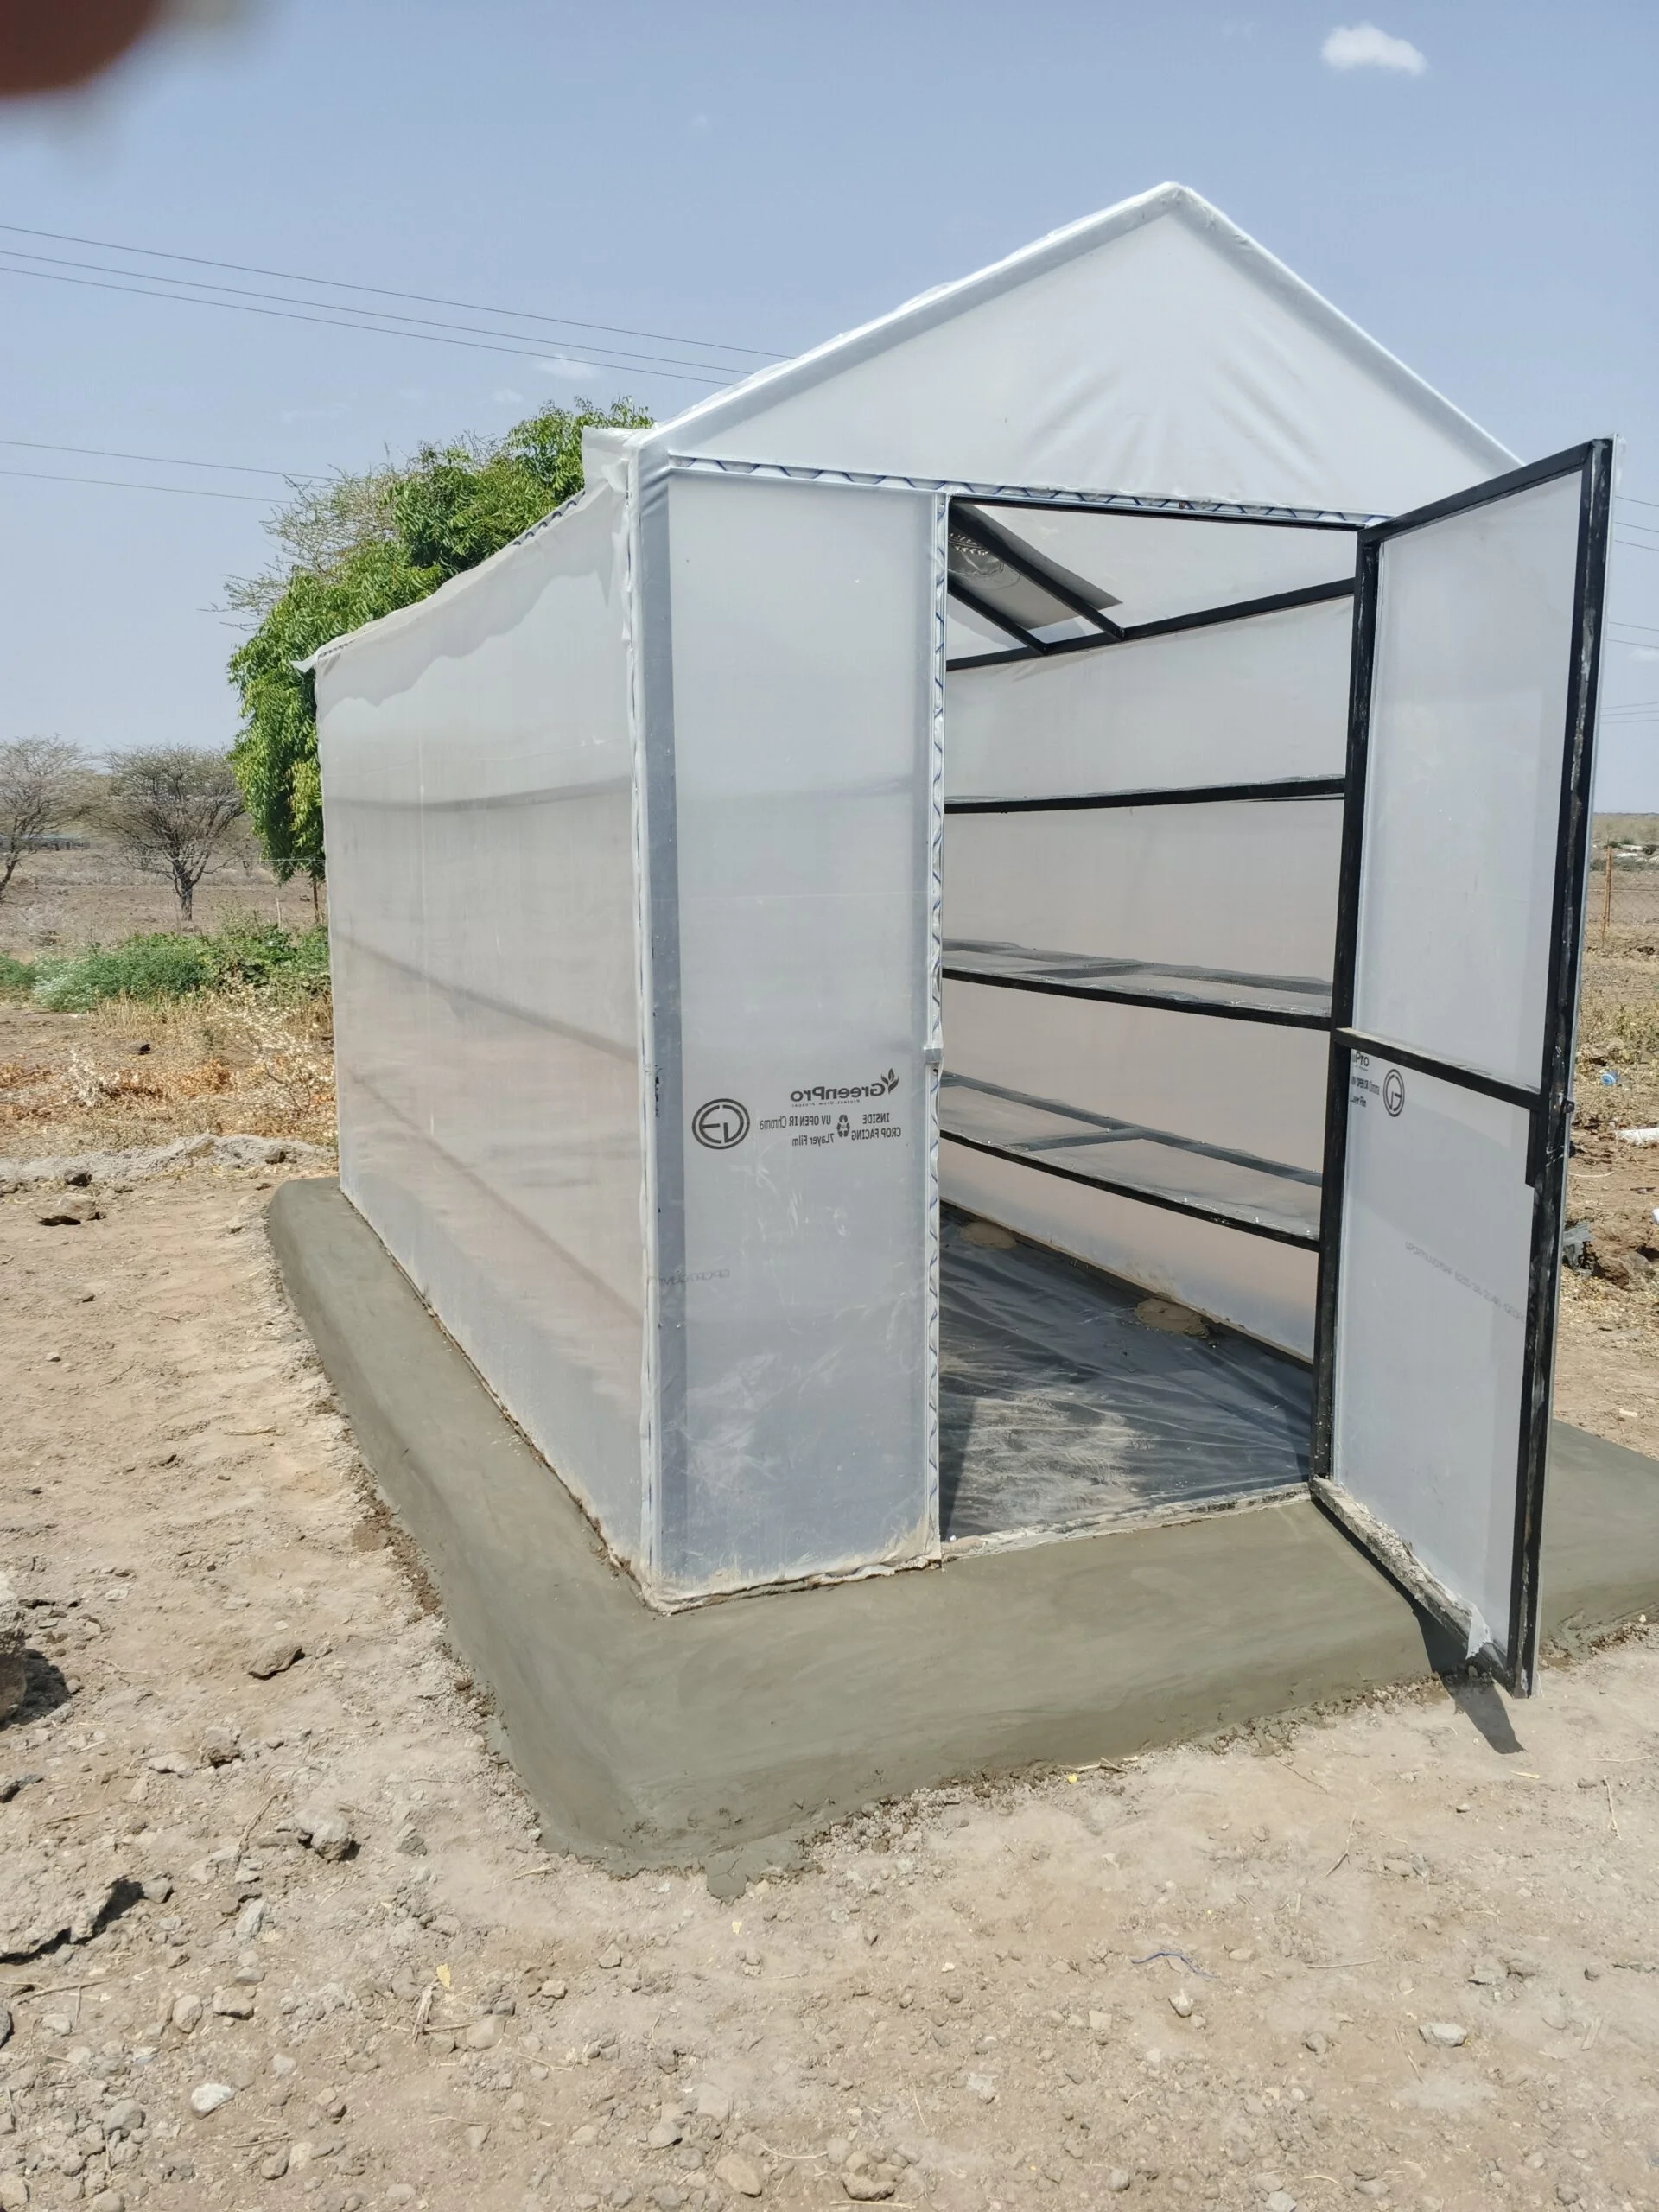

Some Pictures
Food Solar Drier
Jikokoa for Baking

Slide 11
Timeline
ACTIVITY/MONTH | AUG-SEPT 2025 | OCT-NOV 2025 | DEC 2025 | JAN 2026 | FEB-APRIL 2026 | MAY-JUL2026 | AUG 2026
Literature Review & Conceptualization
Nutritional Analysis of Soy By-Products
Bakery Product Development
Organoleptic Evaluation & Data Collection
Data Analysis & Report Writing
Final Report Submission
HCE SOLUTIONS SCHEDULE | PROGRESS AT UMU
OCTOBER 2024-SEPTEMBER 2026 | Coursework completion by early October 2024
 | Data Collection & Lab Work to commence in October to June 2026
 | Graduation in October 2026

Slide 12
Bibliography
Christina A. Nti1, Wisdom A. Plahar2 & Nana T. Annan2 on Development and quality characteristics of shelf-stable soy-agushie
H.E. Snyder, L.A. Wilson, in Encyclopedia of Food Sciences and Nutrition (Second Edition), 2003
Gatsby Africa, Leveraging East Africa’s Soyabean Opportunity, 2024
D.H. Shin, S.J. Jung, Phytochemicals in Soybean: Korean Traditional Fermented Soybean Foods and Their Functionalities,2022
C. Shrivastava, S. Chakraborty, Bread from wheat flour partially replaced by fermented chickpea flour: Optimizing the formulation and fuzzy analysis of sensory data, LWT, Volume 90, 2018. https://doi.org/10.1016/j.lwt.2017.12.019.
K.H. Joo, W.L. Kerr, G.A. Cavender, The Effects of Okara Ratio and Particle Size on the Physical Properties and Consumer Acceptance of Tofu, 2023
J. M. M. Canaan, G. S. P. Brasil, N. R. de Barros, C.U. Mussagy, N. B. Guerra, R. D. Herculano, Soybean processing wastes and their potential in the generation of high value-added products, Food Chemistry, Volume 373, Part B, 2022. https://doi.org/10.1016/j.foodchem.2021.131476
Business Daily, Soya milk offers farmers’ group income stream, 18.12.2020. https://www.businessdailyafrica.com/bd/corporate/industry/soya-milk-offers-farmers-group-income-stream--2044728
Herbert Stone and Joel L. Sidel (2004), Sensory Evaluation Practices.
ISO 11136 (2014), Sensory analysis -Methodology -General guidance for conducting hedonic tests with consumers in a controlled area.

Slide 13

Acknowledgment
HCE SOLUTIONS
Uganda Martyrs University
Funded by European Union - Intra African Academic Mobility Scheme

Slide 14


